Slide 1
Java 11 Features

Slide 2
Agenda
Syntax
var supported in LAMBDA
java.lang.String new methods
Predicate.not()
incubator becomes java.net
Reference clone() update
Environmental
Removed tools
Excluded APIs
Application CDS -Module support
Single-file launch
Compiling threads lazy allocation
G1 update
ZGC – Experimental

Slide 3
Oracle released Java 11 in September 2018, only 6 months after its predecessor, version 10.
Java 11 is the first long-term support (LTS) release after Java 8. Oracle also stopped supporting Java 8 in January 2019. As a consequence, a lot of us will upgrade to Java 11.

Slide 4
Local-Variable Syntax for Lambda Parameters
One enhancement in Java 11 covered in JEP 323 is to allow var to be used when declaring the formal parameters of implicitly typed lambda expressions.
The goal is to align the syntax of a formal parameter declaration in an implicitly typed lambda expression with the syntax of a local variable declaration.

Slide 5
One benefit of using 'var' in lambdas is that , type annotations can be applied to local variables without losing brevity:
(@Nonnull var x, @Nullable var y) -> x.process(y)
Also we can use 'final' with var:
(final var x) -> Math.pow(x, 4)

Slide 6
New String Methods:
isBlank(): This is a boolean method. It just returns true when a string is empty and vice-versa.
lines(): This method is to return a collection of strings that are divided by line terminators.
repeat(n): Result is the concatenated string of original string repeated the number of times in the argument.
stripLeading(): It is used to remove the white space which is in front of the string
stripTrailing(): It is used to remove the white space which is in the back of the string
strip(): It is used to remove the white spaces which are in front and back of the string

Slide 7
Optional.isEmpty()
Optional.isEmpty(): This method returns true if the value of any object is null and else returns false.
jshell>Optional str = Optional.empty();
jshell>str.isEmpty();
Output: true
jshell>Optional str = Optional.of("TonyStark");
jshell>str.isEmpty();
Output: false

Slide 8
Java predicate not() method
In Java 11, Predicate class has new method not().
It returns a predicate that is the negation of the supplied predicate.
This is accomplished by returning result of the calling predicate.negate().

Slide 9
incubator becomes java.net
The incubated HTTP API from Java 9 is now officially incorporated into the Java SE API. The new HTTP APIs can be found in java.net.HTTP.*
The newer version of the HTTP protocol is designed to improve the overall performance of sending requests by a client and receiving responses from the server. This is achieved by introducing a number of changes such as stream multiplexing, header compression and push promises.
As of Java 11, the API is now fully asynchronous (the previous HTTP/1.1 implementation was blocking). Asynchronous calls are implemented using CompletableFuture.The CompletableFuture implementation takes care of applying each stage once the previous one has finished, so this whole flow is asynchronous.
The new HTTP client API provides a standard way to perform HTTP network operations with support for modern Web features such as HTTP/2, without the need to add third-party dependencies.
The new APIs provide native support for HTTP 1.1/2 WebSocket. The core classes and interface providing the core functionality include:
The HttpClient class, java.net.http.HttpClient
The HttpRequest class, java.net.http.HttpRequest
The HttpResponse<T> interface, java.net.http.HttpResponse
The WebSocket interface, java.net.http.WebSocket

Slide 10
Reference clone() update
Object cloning refers to the creation of an exact copy of an object.
It creates a new instance of the class of the current object and initializes all its fields with exactly the contents of the corresponding fields of this object.

Slide 11
Environmental

Slide 12
Tools and Components Not Shipped with JDK 11
Main Tools
appletviewer
See JDK-8200146 : Remove the appletviewer launcher.

Slide 13
Tools and Components Not Shipped with JDK 11
CORBA Tools
idlj
orbd
servertool
tnamesrv
In addition, the rmic (the RMI compiler) will no longer support the -idl or -iiop options. See JDK 11 Release Notes.

Slide 14
Tools and Components Not Shipped with JDK 11
Java Web Services Tools
schemagen
wsgen
wsimport
xjc
See JEP 320: Remove the Java EE and CORBA Modules.

Slide 15
Tools and Components Not Shipped with JDK 11
Java Deployment Tools
javapackager
javaws
Note:pack 200 and unpack200 have been deprecated and might be removed in a future JDK release.
See Removal of JavaFX from JDK and JEP 336: Deprecate the Pack200 Tools and API.

Slide 16
Tools and Components Not Shipped with JDK 11
Monitoring Tools
jmc: In JDK 11, JMC is available as a standalone package and not bundled in the JDK.
See Removal of JMC from JDK and Java Mission Control.
JVM-MANAGEMENT-MIB.mib
The specification for JVM monitoring and management through SNMP JVM-MANAGEMENT-MIB.mib has been removed. See Removal of JVM-MANAGEMENT-MIB.mib.
SNMP Agent
The jdk.snmp module has been removed. See Removal of SNMP Agent.

Slide 17
APIs to Be Removed From Java 11
javax.security.auth.Policy
java.lang.Runtime.runFinalizersOnExit(boolean)
java.lang.SecurityManager.checkAwtEventQueueAccess()
java.lang.SecurityManager.checkMemberAccess(java.lang.Class,int)
java.lang.SecurityManager.checkSystemClipboardAccess()
java.lang.SecurityManager.checkTopLevelWindow(java.lang.Object)
java.lang.System.runFinalizersOnExit(boolean)
java.lang.Thread.destroy()
java.lang.Thread.stop(java.lang.Throwable)

Slide 18
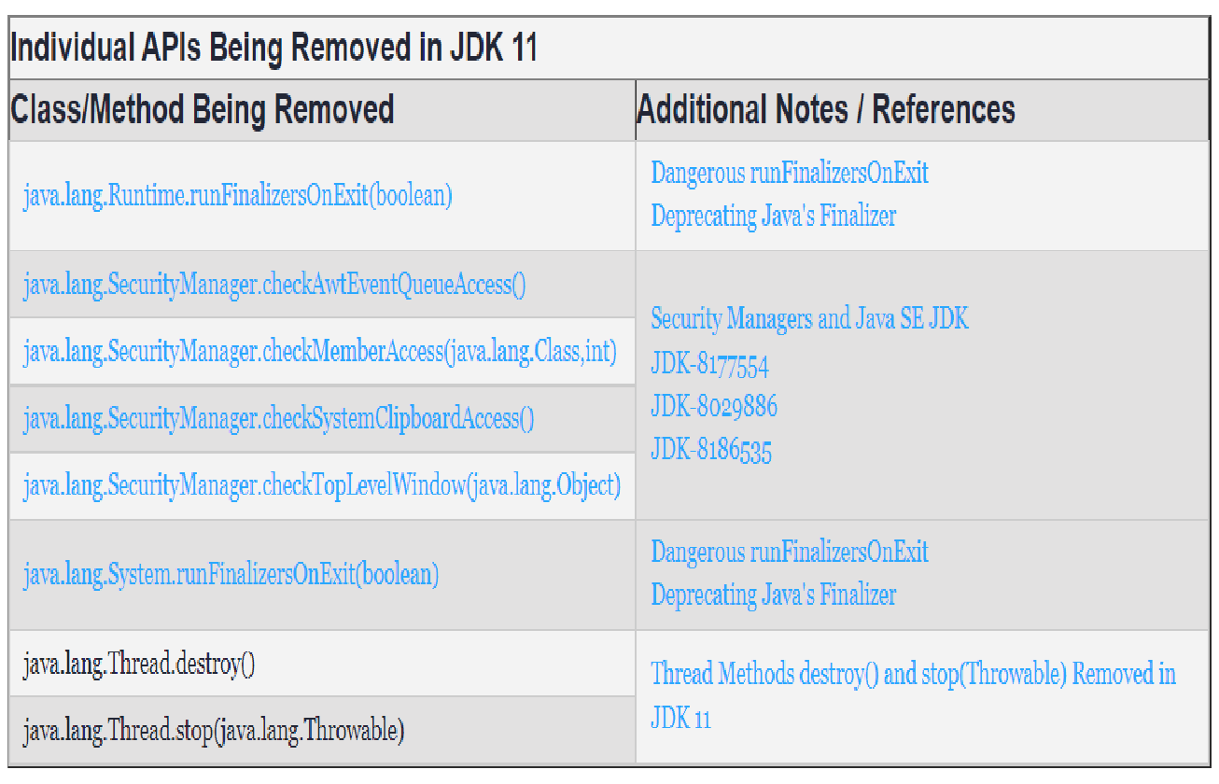

Slide 19
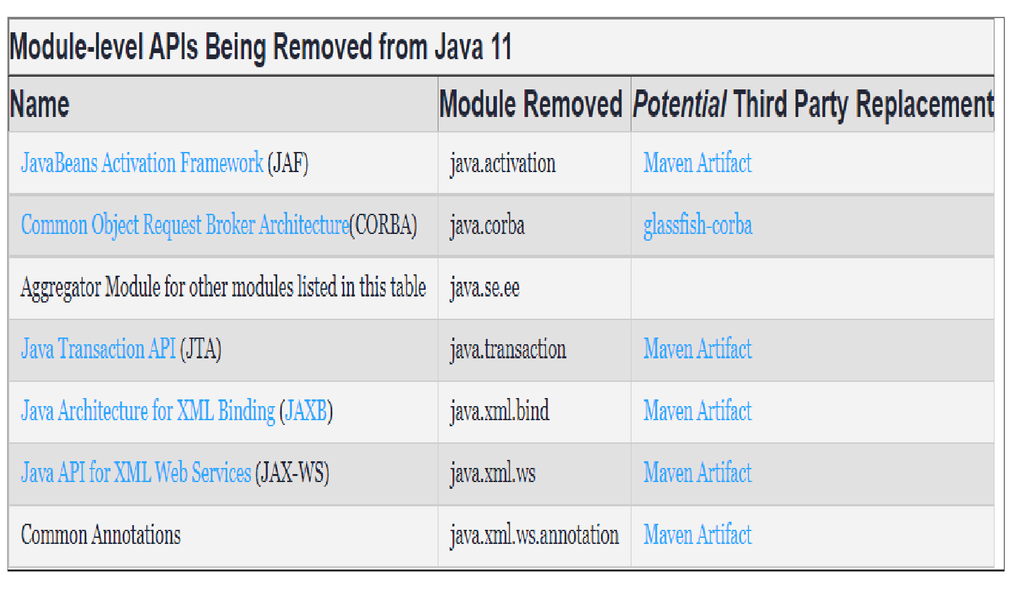

Slide 20
Application CDS -Module support
The class data sharing (CDS) feature helps reduce the startup time and memory footprints between multiple Java Virtual Machines (JVM) which was a big foot forward here.
When you use the installer to install the Oracle Java Runtime Environment (JRE), the installer loads a default set of classes from the system Java Archive (JAR) file into a private internal representation and dumps that representation to a file called a shared archive.
If the JRE installer is not being used, then you can generate the shared archive manually. When the JVM starts, the shared archive is memory-mapped to allow sharing of read-only JVM metadata for these classes among multiple JVM processes.
Because accessing the shared archive is faster than loading the classes, startup time is reduced.

Slide 21
C:\Users\Administrator\eclipse-workspace\Java 11Features\src\com\java\CDS>javac Test.java
C:\Users\Administrator\eclipse-workspace\Java 11 Features\src\com\java\CDS>java Test.java
Hello all
0.820257054062783
java -verbose:class com.java.CDS.Test.java
>c:\log.txt

Slide 22
Launch Single-File Source-Code Programs in JDK 11
JDK 11 will allow you to run your Java source directly with the Java interpreter.
From Java 11, Java provides flexibility to run Java code without compilation. It means we can execute Java code in a single step.
Before Java 11, if we execute Java file then first, we need to compile the code and then run the code. This whole process requires two major steps:
Compile Java code
Run Java code
To compile the code, we use javac java_file.java command. and
To run this file, we use java java_file command in the terminal (cmd in windows).
But if we are working with Java 11 then we don't need to follow these two steps. Just use single command java java_file.java and it will execute the file by producing the desired result.
Note: This feature is applicable if we have a single file of source code. It means all the code is in a single file, with no external dependency.

Slide 23
C:\Users\Administrator\eclipse-workspace\Java 11 Features\src\com\java\LaunchSingleFile>java SingleLaunch.java
Hello World!!!
This code is executed without explicit compilation!
With Command Line Arguments
C:\Users\Administrator\eclipse-workspace\Java 11 Features\src\com\java\LaunchSingleFile>java Greeting.java geetha
Hello geetha!!
Multiple Classes in a Single File
C:\Users\Administrator\eclipse-workspace\Java 11 Features\src\com\java\LaunchSingleFile>java .\SimpleInterest.java 1000 2 10
Simple Interest is: 200.0

Slide 24
Folder Structure
C:\Users\Administrator\eclipse-workspace\Java 11 Features\src>tree /f

